Slide 1
TYPES OF ESSAY

Slide 2
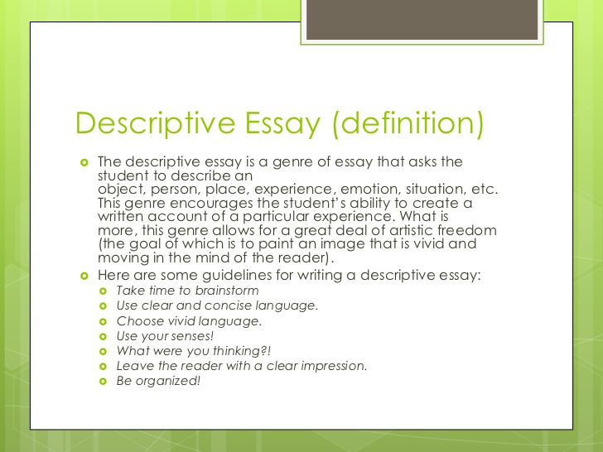

Slide 3
DESCRIPTION: Specific detail & imagery makes reader feel present in the moment
Description should be present in any type of writing, from narration to the others covered here.
Think about the dominant impression you want to give; don’t attempt to describe every single thing.
Use imagery to put your reader right there with you.
Order events in time and space in such a way that the reader can imagine the location and time easily.
BE SPECIFIC!
Instead of: I got home and put my books down on the couch. Then, I ate some food.
Try: After throwing my dog-eared books on the dusty sofa, I settled down to a snack of crisp, yellow corn chips accompanied by spicy tomato salsa spilling over the top of an earthen-ware bowl.

Slide 4
Cont….
BE INTERESTING!
Instead of: After my mom yelled at me, I was sad and mad. I wanted to yell back, but I knew I’d get in bad trouble. So, I hid in my closet and cried.
Try: “Get the hell out of here, you brat!” my mother would yell. I felt hollow inside, like a pumpkin with the seeds scooped out, and as mad as a raging bull. I wanted so badly to yell back at her, but, knowing the consequences would be unspeakable, I curled up in the corner of my dark, quiet closet and cried.
AVOID SWEEPING GENERALIZATIONS! Use specific examples that you can back up -- or write with moderation.
Instead of: People all around the world have hated animal abuse and will do so for all time.
Try: City records reveal that many citizens are quick to call the police if they hear of an animal being abused. I’m not surprised, because I’ve done this myself. I hope it will be a long time before people become too complacent to report such injustices to our fellow living creatures.

Slide 5
Cont….
USE ADJECTIVES AND ADVERBS!
Instead of: It was hot. In the afternoon, we rested on a log before hiking further into the woods.
Try: One afternoon sun began to blaze down upon us, exhaustion set in, and we collapsed on a nearby moss-covered log, groaning under the weight of its ancient branches. Our hike into the heart of the forest would soon resume.
USE A THESAURUS!
Instead of: old try: elderly, aged, long in the tooth
clean try: spotless, hygienic, sterile
good try: marvellous, wonderful, incomparable, unrivalled
bad try: dreadful, horrific, appalling, ghastly

Slide 6
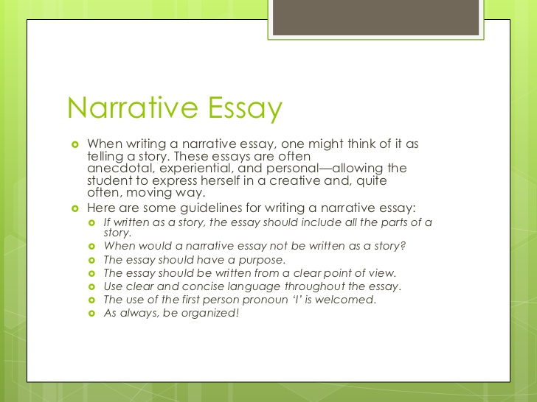

Slide 7
NARRATION: an account of something that happened; a story
Narration has the following elements:
Situation: The background; who, what, when, and where of the account.
Conflict: The problem, friction, or issue at the heart of the story.
Struggle: What happened? The struggle adds action and develops the plot. Outcome: Result of the struggle; the resolution. Meaning: Lessons learned; the “moral of the story.”
Use:
Description techniques
Dialogue (What people said, in quotation marks, using quotation indicators like He said, She said, etc.)
Transitional words, like Then, Soon, Later, On the other hand, For example, etc. But, avoid: I did this; then I did that. Then, we did this. Then we did that. Next, we did this. → too boring!

Slide 8
Cont….
Verb tense: Should usually be the past tense, even when recounting something that happened to you and telling the story as though the reader is with you at the time. Pick a tense and stick with it!
Point of View (POV): Will often be the first person (I did this; then I did that; it was my problem), but the writer may also be writing about someone else: (My father drove away; then he called my mother; she answered.)
May be third person if the writer is telling a story from a distance, for example, writing a biographical narrative about someone else.

Slide 9
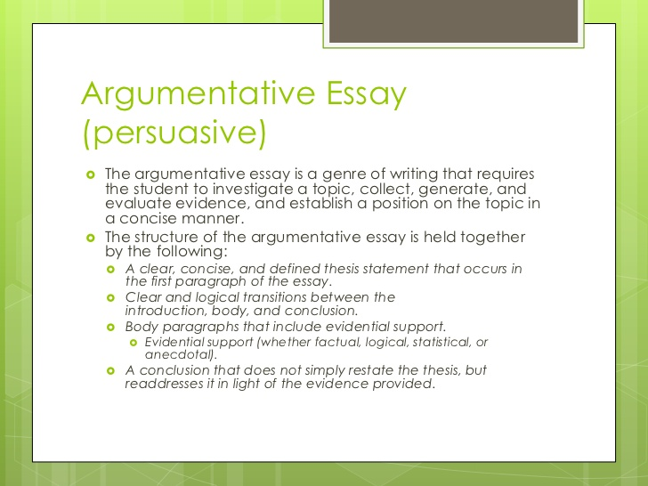

Slide 10
THE ARGUMENTATIVE OR PERSUASIVE ESSAY: For arguing & supporting your positions
Essay Parts:
1. Background: historical & social context of a controversial issue
2. Proposition: your thesis statement; what you will argue, including a roadmap of how you will argue it
3. Qualifications: any limitations to your argument; for example, you may be opposed to child labour, except in cases of poverty or unemployment.
4. Refutation: identification of the opposing position and its flaws (provide evidence!)
5. Support: your reasoning, facts, examples, statistics, opinions of authorities, and other evidence to make your case
6. Conclusion: come full circle, with a conclusion that restates your thesis and shows how you have made your case, summarizing the most important points you made

